Slide 1
Solar Energy, Seasons, and the Atmosphere
Week 2

Slide 2
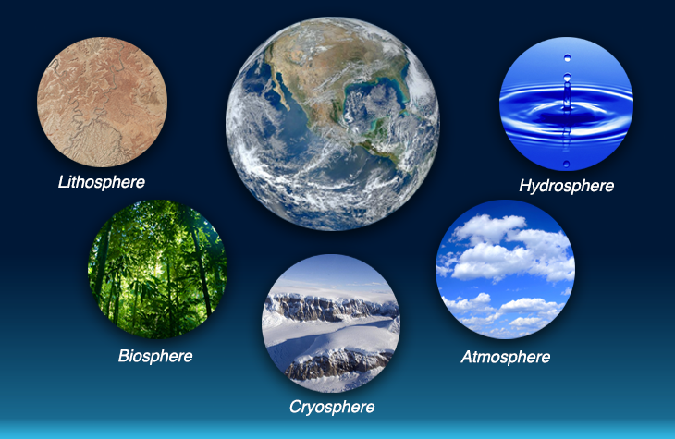
Review

Slide 3
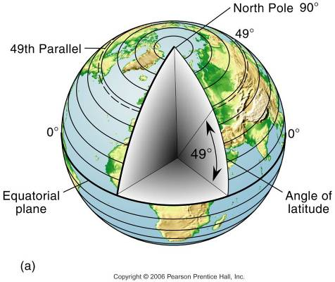
Review
Latitude
Divides Earth into hemispheres
Parallels = lines connecting all points along the same latitudinal angle
Measured north and south

Slide 4
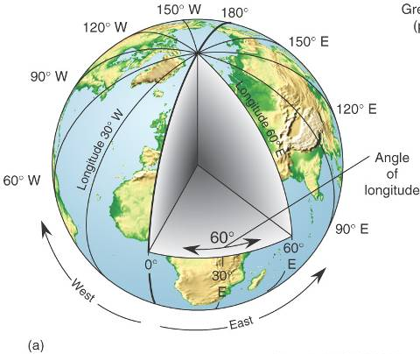
Review
Longitude
Divides the Earth in half
Meridians = lines connecting all points along the same longitude
Meridians measure east and west

Slide 5
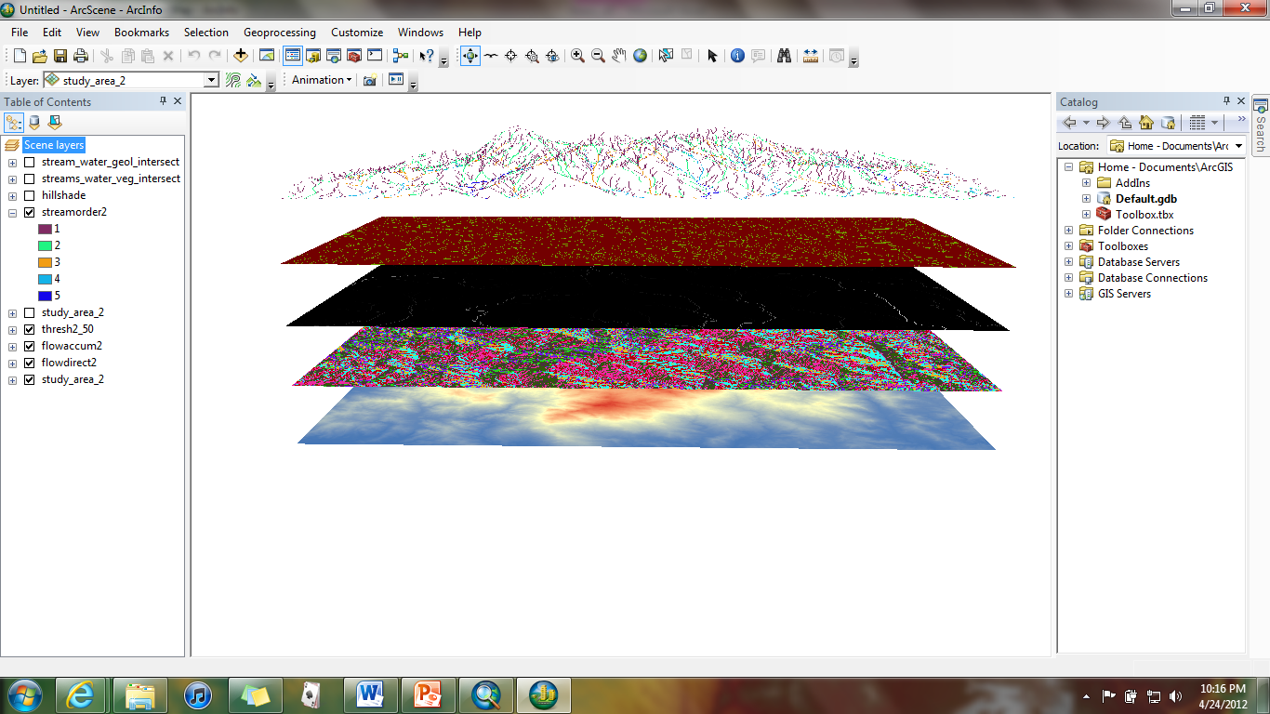
Review
GIS stands for either Geographic Information System(s) or Geographic Information Science depending on the usage
A “system” can be thought of as a spatial model used to portray something about the Earth or reality
The “Science” is the discipline of studying spatial analysis using GISystems

Slide 6
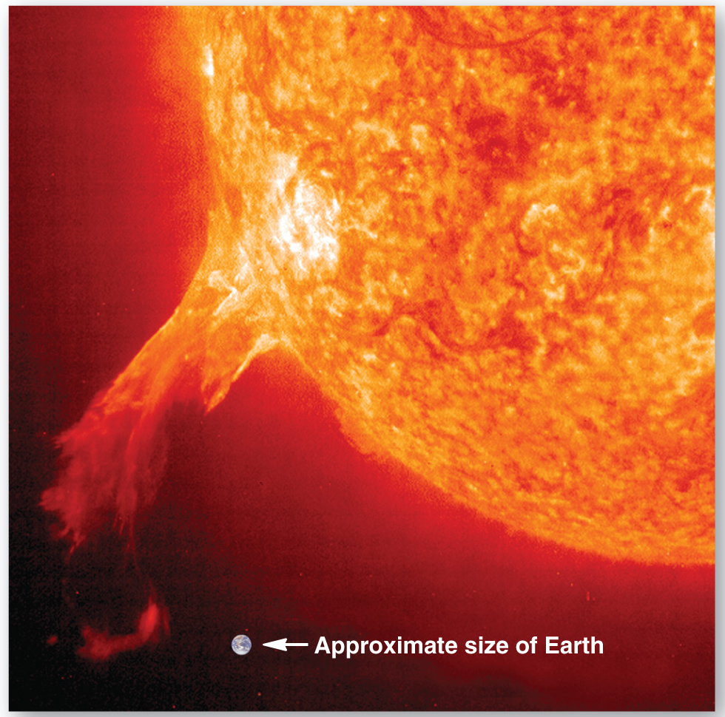
From Sun to Earth
Two primary outputs from the sun are solar wind and radiant energy
Solar wind – stream of electrically charged material that is emitted from the sun
Takes approx. 3 days to reach Earth

Slide 7
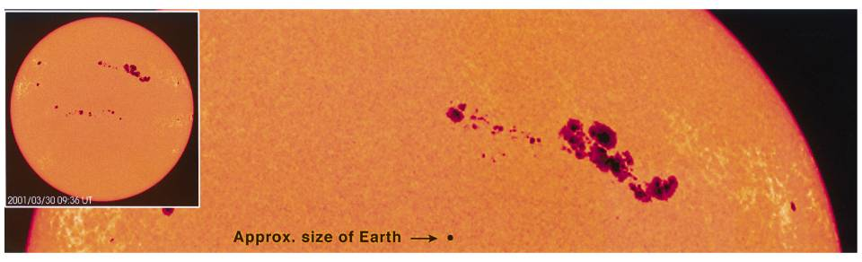
Solar Activity
Sunspots – surface disturbances on the sun that are caused by magnetic storms
Outburst of charged material from sunspots can also add to the solar wind
Regular 11-year cycle of sunspot activity

Slide 8
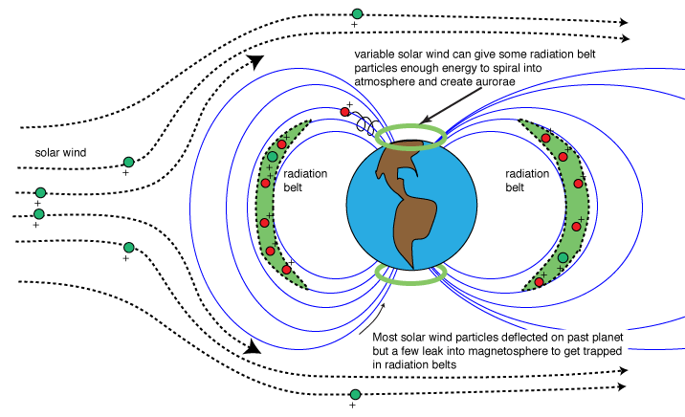
Solar Wind Effects
Charged solar wind particles are deflected by the magnetosphere
Magnetic field surrounding Earth

Slide 9
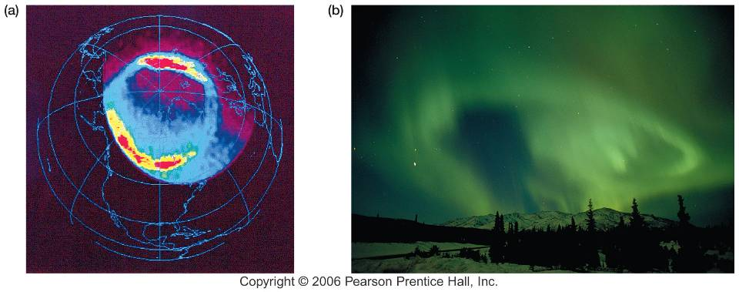
The Auroras
The particles enter the upper atmosphere at the poles creating the aurora borealis (northern lights) and aurora australis (southern lights)

Slide 10
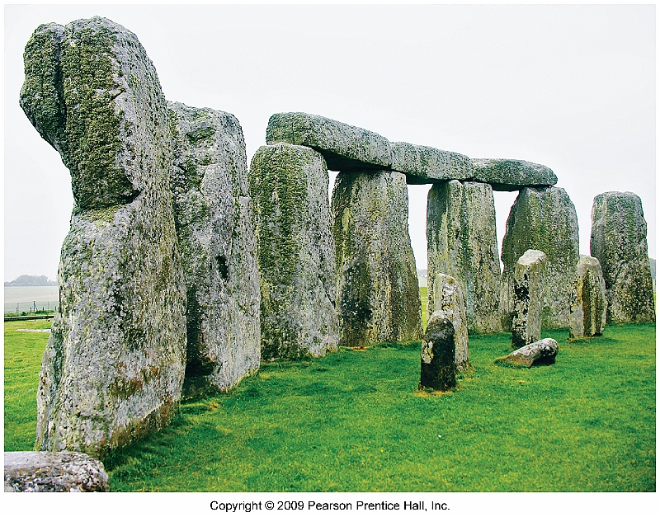
The Seasons
Seasonality – the changing of the Sun’s position relative to Earth, and the changing daylengths during the year

Slide 11
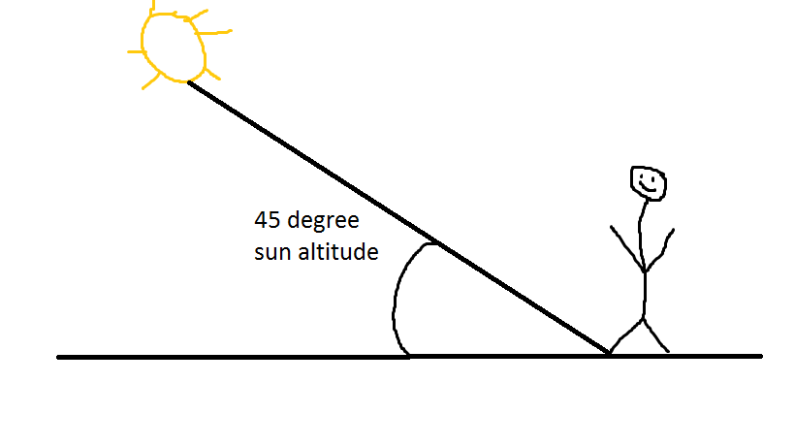
Sun’s Position in the Sky
Sun Altitude – the angle between the horizon and sun (range from 0 to 90 degrees)
Subsolar point – location where the sun altitude is exactly 90 degrees

Slide 12
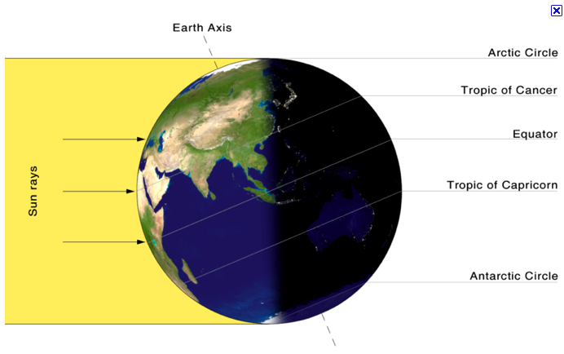
Sun’s Position in the Sky
The latitude of the subsolar point is known as the Sun’s declination.
Declination migrates between 47 degrees of latitude.
Daylength is influenced by latitude!

Slide 13
Reasons for Seasons
Five Primary Reasons for the Seasons:
Earth’s Orbit
Earth’s Rotation
Tilt of the Earth’s Axis
Axial parallelism
Sphericity
**All five of these work together to create the seasonality of a location

Slide 14
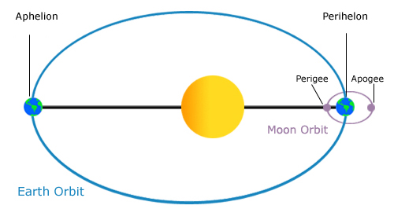
Earth’s Orbit
(1) Earth’s Revolution
365.25 days for the Earth to complete a rotation
The shape of the orbit and speed are the two properties that dictate the seasons.

Slide 15
Earth’s Orbit
(1) Earth’s Revolution
Perihelion – when the Earth is closest to the Sun (Jan 3rd)
Aphelion – when Earth is farthest from the Sun (July 4th)

Slide 16
Earth’s Rotation
(2) Earth’s Rotation
24 hours to complete one rotation
Circle of Illumination – dividing line between day and night.

Slide 17
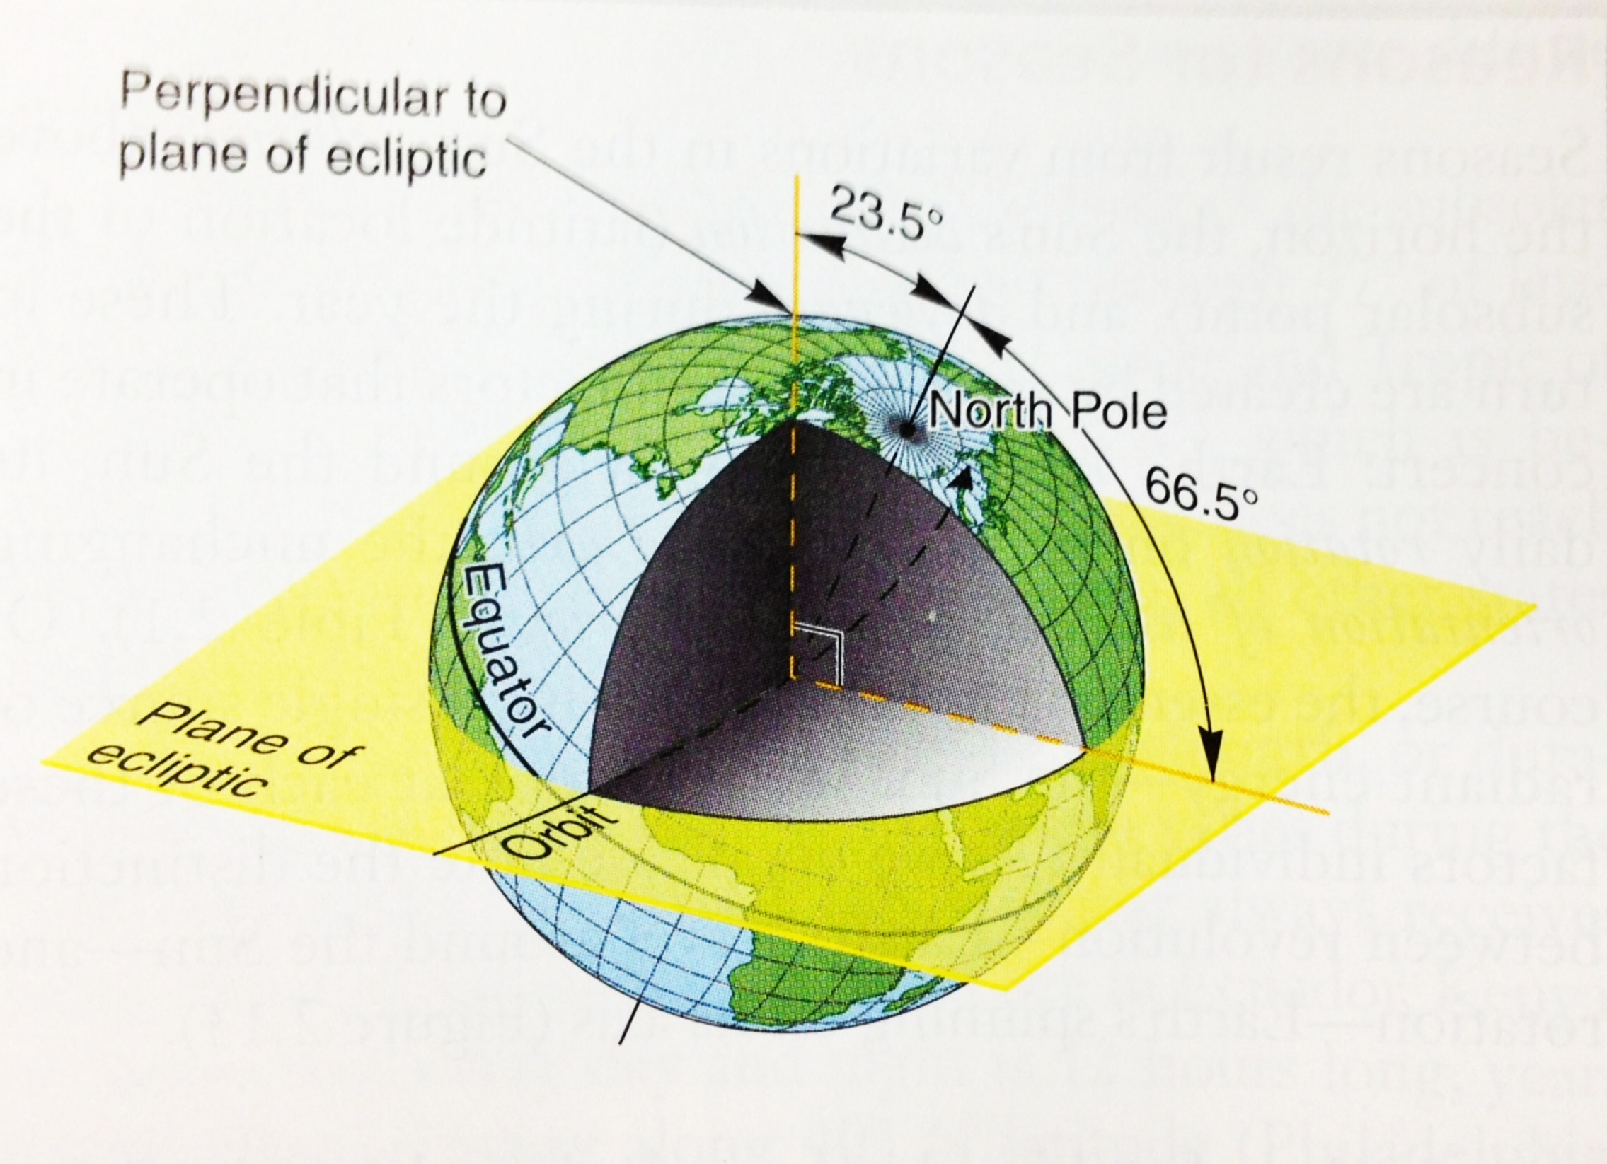
Axial Tilt
(3) Tilt of the Earth
23.5 degrees
Controls the location of the circle of illumination.
Arctic and Antarctic circles are found at 66.5 degrees north and south (90-23.5=66.5)

Slide 18
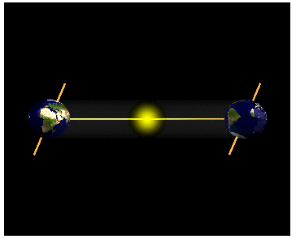
Axial Parallelism
Earth’s axis maintains the same alignment relative to the plane of the ecliptic as it moves around the sun (constant tilt throughout year)

Slide 19
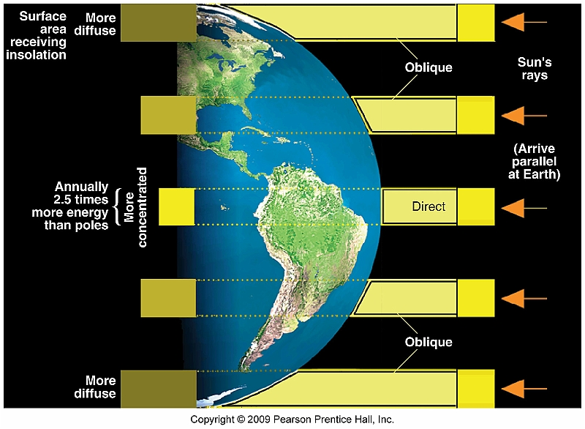
Sphericity
Remember, Earth is not a perfect sphere
BUT, the surface is curved and creates an uneven receipt of radiation
Be sure you understand this figure!

Slide 20
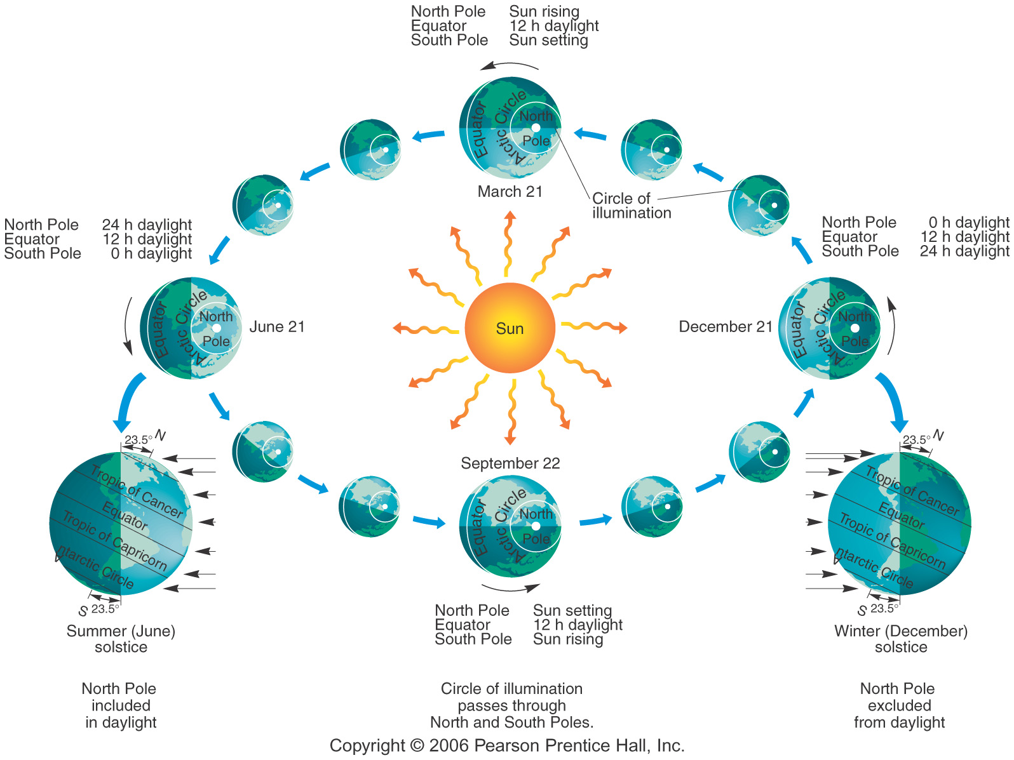
Study Card: March of the Seasons

Slide 21
Study Card: Important Dates
December Solstice – December 21/22
March Equinox – March 20/21
June Solstice – June 20/21
September Equinox – September 22/23

Slide 22
Study Card: Important Locations
Equator (0 °)
Tropic of Cancer (23.5°N)
Tropic of Capricorn (23.5°S)
Arctic Circle (66.5° N)
Antarctic Circle (66.5°S)

Slide 23
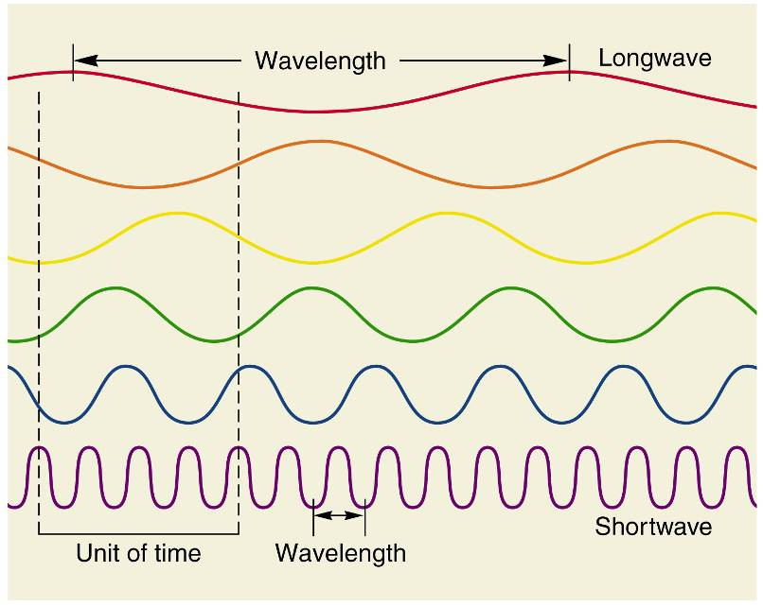
Radiant Energy
Essential to life on Earth.
Radiant energy travels in waves.
Frequency- the number of waves passing a fixed point in 1 second

Slide 24
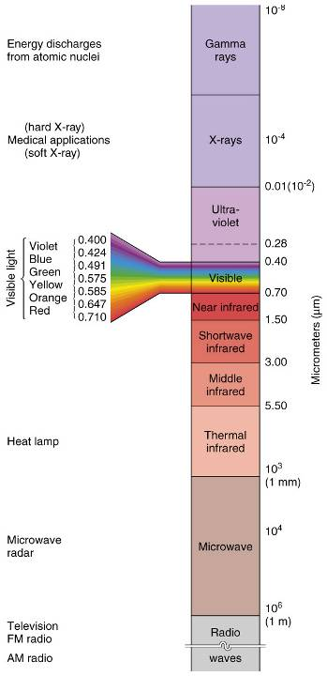
Electromagnetic Spectrum
HIGH
We can represent the range of wavelengths emitted by the sun into the sun’s EM Spectrum
Visible light and infrared wavelengths
Note which are low and high frequency waves
LOW

Slide 25
Wavelengths of Visible Light
The range for visible light is ~ 0.4 to 0.7 micrometers
Know the relative wavelengths for visible light!

Slide 26
Wavelengths and Temperature
All objects radiate energy in wavelengths relative to individual surface temperature
The hotter the object…
the shorter the wavelength…
the higher the energy.

Slide 27
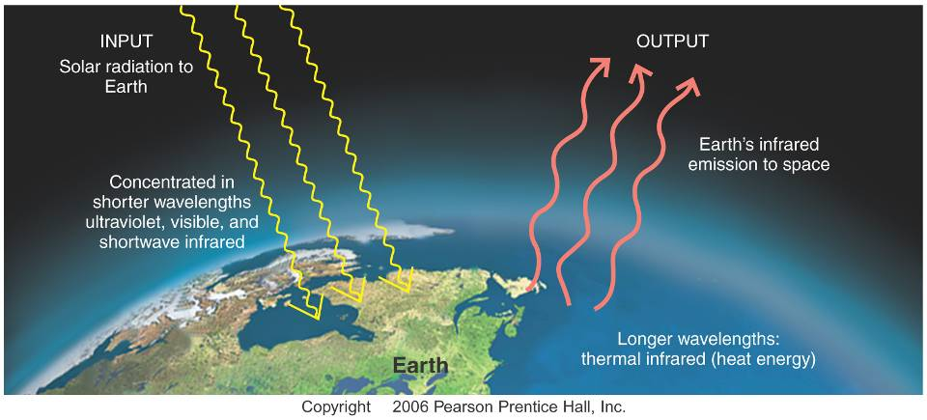
Earth’s Energy Budget
Here’s a simplified diagram, but these are the basics

Slide 28
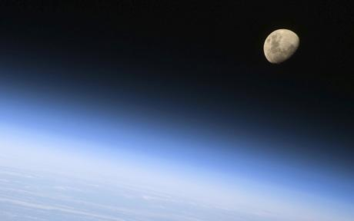
Solar and Terrestrial Energy
Insolation (incoming solar radiation) – this is radiation arriving to Earth from the sun
Solar Constant – average insolation received at the thermopause (1372 W/m²).

Slide 29
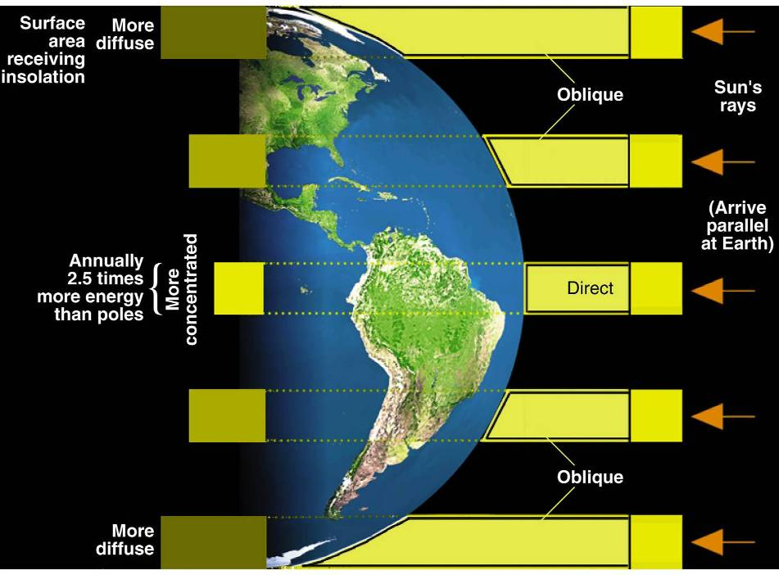
Insolation on a Curved Earth

Slide 30
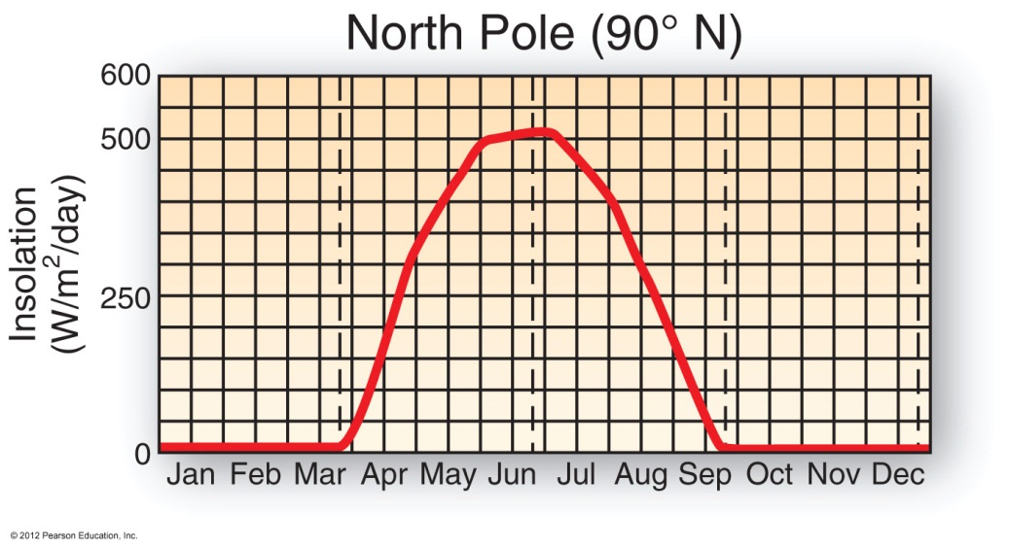
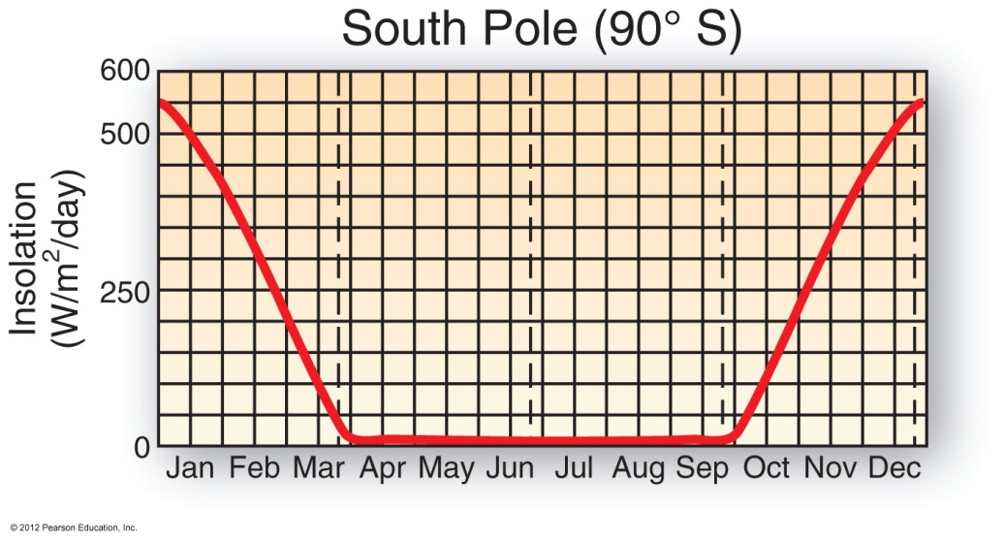
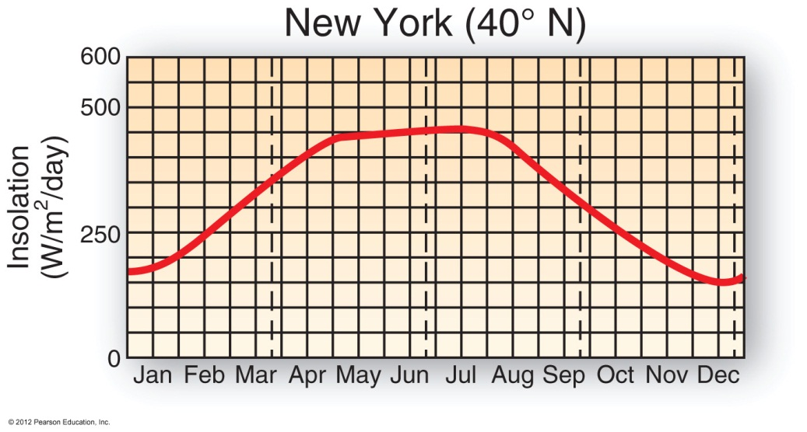
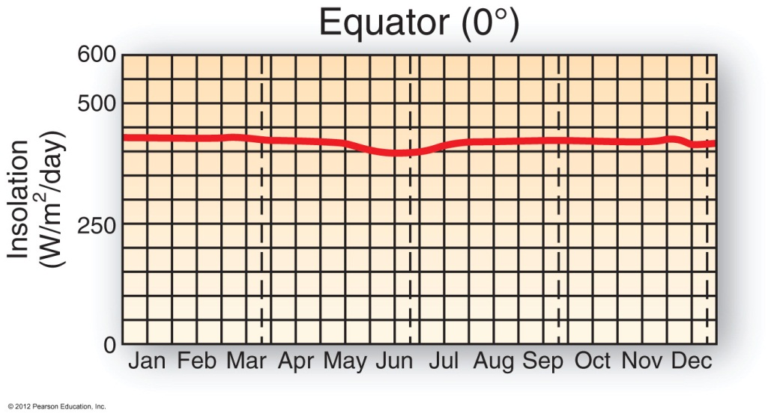
Uneven Distribution of Insolation
Be sure you understand these!

Slide 31
Atmospheric Profile
Earth’s atmosphere is composed of “shells” held to the planet by gravity.
Classified by:
Composition
Temperature
Function
We’ll go over each of these in the next few slides…

Slide 32
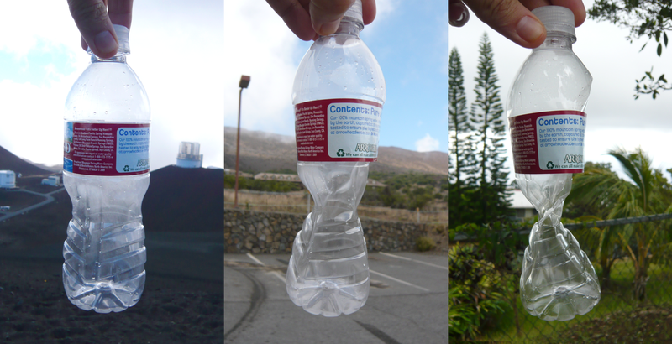
Physical Profile
Air molecules are pulled down by gravity, creating pressure
Average sea-level pressure (our baseline) is 1013.2 mb
It’s how we know if current pressure is high or low
Water Bottle test on ATM pressure!
Far left = top of mountain, far right = base of mountain

Slide 33
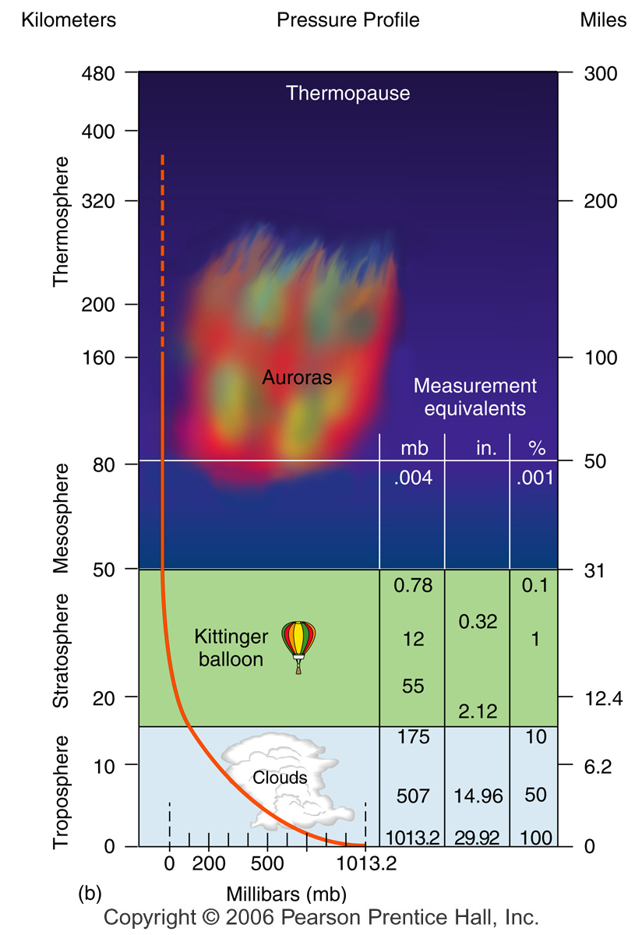
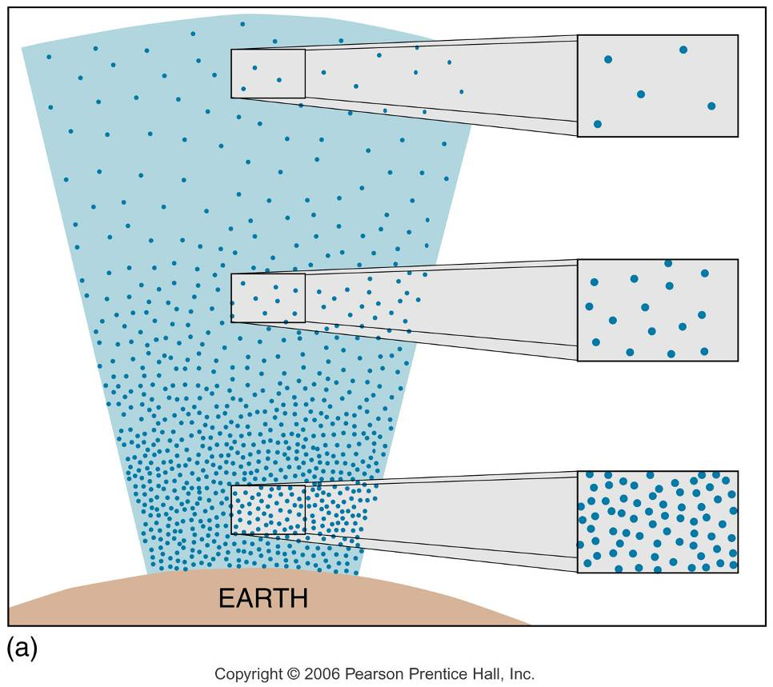

Slide 34
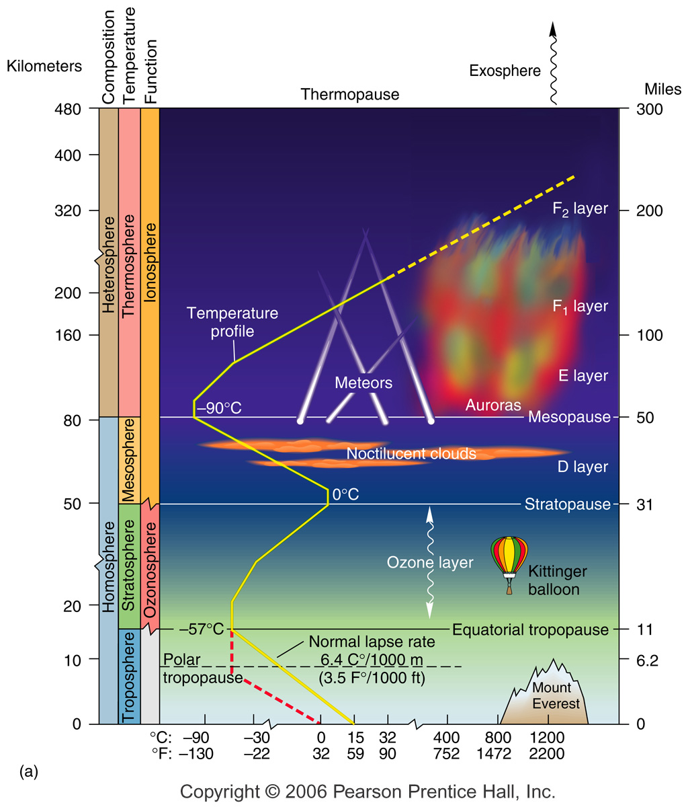
Atmospheric Composition Criterion
Heterosphere -gases are not evenly mixed
sorted by gravity according to atomic weight
Homosphere -gases are uniform, no distinct layers

Slide 35
Atmospheric Temperature Criterion
Thermosphere
Mesosphere
Stratosphere
Ozone concentrated here
Troposphere
Weather occurs here

Slide 36
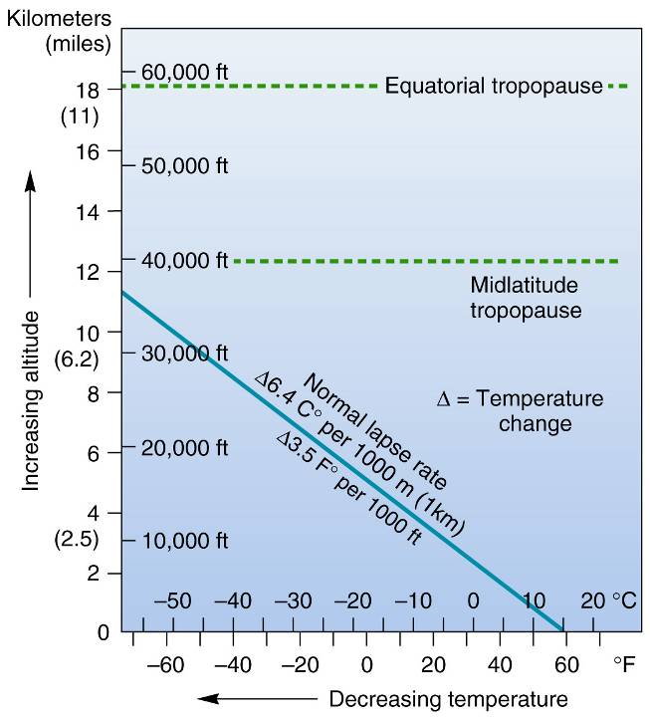
A closer look at the troposphere…
Normal Lapse Rate – decrease in temperature with increase in altitude at an average of 6.4°C/1000m
Environmental Lapse Rate – actual local lapse rate. This will vary by area, time of day, etc.
We will return to the ELR when we get to weather and atmospheric moisture in Chp. 5, so stay tuned! ☺

Slide 37
Atmospheric Function Criterion
Ionosphere
Absorbs cosmic, gamma, UV, and X-rays
Auroras
Ozonosphere
High ozone concentrations
Absorbs UV rays, reradiates as infrared (heat) energy

Slide 38
Looking Ahead
Next week we begin Chp. 3 and our topics will continue to build. Be sure to reach out if you have questions or concerns!
Lab #3 is next week!

